Slide 1


AI-Driven Anomaly Detection for Real-Time Monitoring of IoMT Networks
The Internet of Medical Things (IoMT) has transformed healthcare by enabling real-time patient monitoring and remote diagnosis. However, the rapid growth of IoMT networks introduces new cybersecurity risks, including cyber-attacks and data breaches. Traditional security methods struggle to keep up, making AI-based anomaly detection essential for protecting these systems. Leveraging machine learning and deep learning, AI models identify both known and unknown threats in real time, enhancing patient safety and network security.

Slide 2
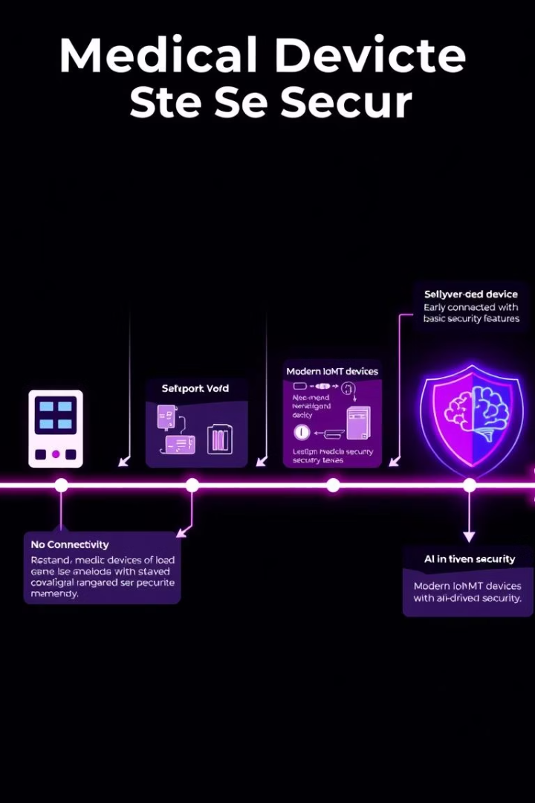
Evolution and Challenges of IoMT Security
Early Medical Devices
Initially, medical devices operated independently without network connections, limiting cybersecurity risks. However, they lacked basic security measures, making them vulnerable to internal threats.
Connected Healthcare Systems
With the rise of hospital networks and wireless medical devices, vulnerabilities increased dramatically. Cyberattacks targeting patient data and device control became a serious threat to safety and privacy.

Slide 3
AI Models for Real-Time Anomaly Detection
Rule-Based Systems
Explainable AI (XAI)
Simple and low on computational needs, these systems detect threats by applying predefined rules to network behavior, suitable for resource-limited IoMT devices.
XAI enhances trust by providing human-understandable explanations of AI decisions, enabling healthcare professionals to interpret anomaly detection results confidently.

Slide 4

IoMT Network Risks and Device Vulnerabilities
Limited Processing Power
Outdated Software
Many devices run unsupported or legacy software, increasing susceptibility to cyberattacks and data breaches.
IoMT devices often have low-power processors, restricting their ability to run advanced security protocols and real-time encryption.
Weak Authentication & Unencrypted Data
Default passwords and unencrypted transmissions expose devices to unauthorized access and data interception.

Slide 5
AI Techniques for Anomaly Detection in IoMT
Supervised Learning
Unsupervised Learning
Support Vector Machines (SVM)
K-Means Clustering
Random Forest (RF)
Principal Component Analysis (PCA)
Decision Trees (DT)
Autoencoders
Uses labeled data to classify normal and abnormal patterns for threat detection.
Discovers hidden patterns in unlabeled data, ideal for exploratory anomaly detection.

Slide 6

Deep Learning Approaches in IoMT Security
Convolutional Neural Networks (CNNs)
Recurrent Neural Networks (RNNs) & LSTMs
Generative Adversarial Networks (GANs)
Effective for analyzing medical images like X-rays and MRI scans to detect irregularities.
Handle sequential medical data, improving detection of anomalies in time-series signals.
Generate synthetic data to enhance training and improve anomaly detection accuracy.

Slide 7





Future Directions in AI-Based IoMT Security
Efficient AI Models
Develop lightweight algorithms optimized for limited IoMT device resources.
Federated Learning
Train AI locally on devices to preserve data privacy without centralizing sensitive information.
Advanced Threat Intelligence
Predict and mitigate cyber threats proactively with AI-driven risk assessment.
Quantum AI
Leverage quantum computing to enhance AI processing power for faster anomaly detection.

Slide 8

Conclusion and Research Outlook
AI Enhances IoMT Security
Focus on Privacy and Efficiency
AI-based anomaly detection improves real-time threat identification and patient safety.
Future research must balance computational efficiency with privacy preservation and evolving cyber threats.
Building Resilient Healthcare Systems
Advancements in AI will strengthen healthcare networks against cyberattacks, ensuring reliable and secure services.

